Slide 1


Performing and rehearsing
Year 8 – KS3

Slide 2
Aims & objectives
Plan and organize strategies to rehearse a piece of music
Rehearse and monitor own work
Evaluate and direct future learning when rehearsing

Slide 3
1 - Plan & organise
The task it to learn to play ‘Ode to joy’ on an instrument of your choice.
Look at the score with a partner.
Discuss
(jot down your thoughts on the graphical organiser)
What prior knowledge will help you with the task?

Slide 4
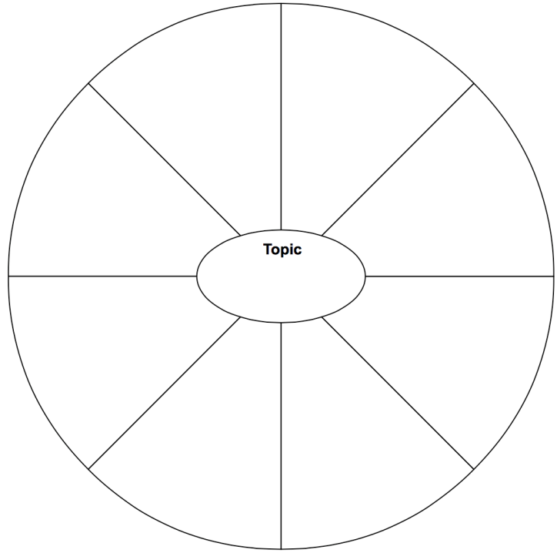

Ode to joy

Slide 5
Sand timer
2 minutes
End

Slide 6
Pace
Time
Signature
Pitch
(leaps, steps)
Key Signature
Ode to joy
Rhythm
Structure
Dynamics
Left hand

Slide 7
1 – Discussion (mini plenary)
Is this similar to anything you have done before?
How is it similar?
How is it different?
Are there any things that are totally new? How will you approach these?
How will your prior knowledge help with today’s learning?

Slide 8
2 - Plan & organise
Individual Practice strategies | Class Practice strategies
1 | 1
2 | 2
3 | 3
4 | 4
5 | 5

Slide 9
Sand timer
2 minutes
End

Slide 10
2 – Questions to consider
  What should we / I do first?
  What should we / I look for in this work?
  What practicing techniques will we / I need to consider?
  How can we / I improve our knowledge of the given piece?

Slide 11
2 - Plan & organise
Individual Practice strategies | Class Practice strategies
1 Practice one bar at a time | 1 Clap the rhythm
2 | 2
3 | 3
4 | 4
5 | 5

Slide 12
3 - Plan & organise
Model Good Practice
Take ideas on board from you…..
Possible activities….
Listen to a performance
Clap a rhythm
Follow score as we listen

Slide 13
4 - Plan & organise
 | Initial strategies for rehearsing | How should I proceed
1
2
3

Slide 14
4 - Plan & organise
 | Initial strategies for rehearsing | How should I proceed
1 | Rehearse first line only
2 | Record myself playing and listen back
3 | Go back to beginning every time I have an error in rhythm or pitch

Slide 15
1 – Monitor own work
Rehearsal time individually
8 minutes to rehearse piece
Remember to follow your strategy

Slide 16
Sand timer
5 minutes
End

Slide 17
Questions
How am I doing? Am I following set 3 personal strategies?
Am I on the right track?
What have I achieved?
What needs to be changed in my strategies?

Slide 18
4 - Plan & organise
 | Initial strategies for rehearsing | How should I proceed
1 | Rehearse first line only | Strategy worked well need to move to second line.
2 | Record myself playing and listen back | Need to record myself again performing both lines.
3 | Go back to beginning every time I have an error in rhythm or pitch | This strategy doesn’t work well as I need to carry on despite the errors.

Slide 19
1 – Monitor own work
Second - Rehearsal time individually
5 minutes to rehearse piece
Remember to follow your strategy

Slide 20
Sand timer
5 minutes
End

Slide 21
1 – Self – reflect (evaluation)
Pair discussion
How well did I do?
How effective were the strategies for rehearsing?
What did I learn?
Did I get the results I expected?
What could I have done differently?

Slide 22
Sand timer
2 minutes
End

Slide 23
2 – Direct own future learning
What changes need to be made on practicing strategies in future?
Is there anything I don’t understand?
How might I apply this thinking to other subjects / problems?

